Slide 1
Nurses Can Do That…

Slide 2
We all know that nurses take care of
people

Slide 3
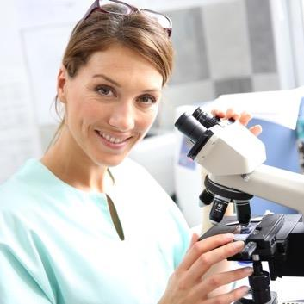
But they can also be…
scientists
teachers
counselors

Slide 4
And sometimes they are…
Super Heroes!

Slide 5
Nurses Are Respected and Trusted
They are the backbone of healthcare

Slide 6
Nurses take care of those in need
But
taking care of the sick is only one piece of the giant puzzle
nurses help assemble every day

Slide 7
Nurses Work Hard To:
Promote healthy living
Prevent and manage diseases
Make a positive
impact on
communities
Save
lives

Slide 8
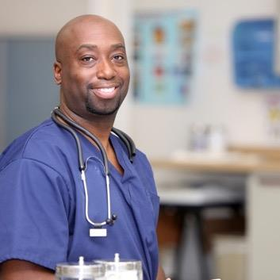
Where Do Nurses Work?
Schools
Hospitals
Doctors
offices

Slide 9
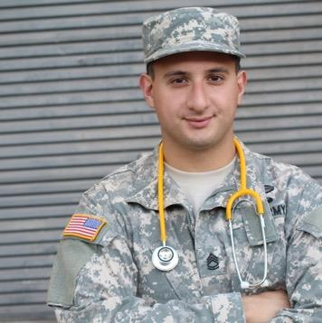
Where Do Nurses Work?
Clinics
Nursing
Homes
The Military

Slide 10
Where Do Nurses Work?
Sometimes in patient homes

Slide 11
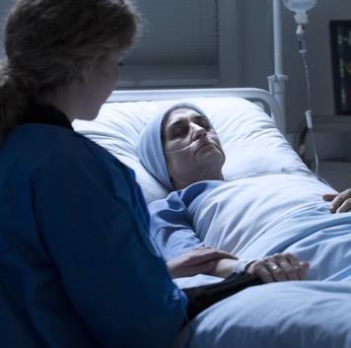
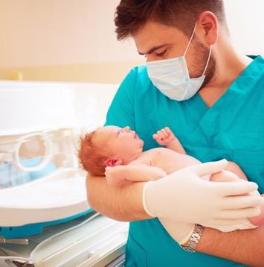
Who Do Nurses Care For?
Babies who have just arrived
People who are very sick

Slide 12
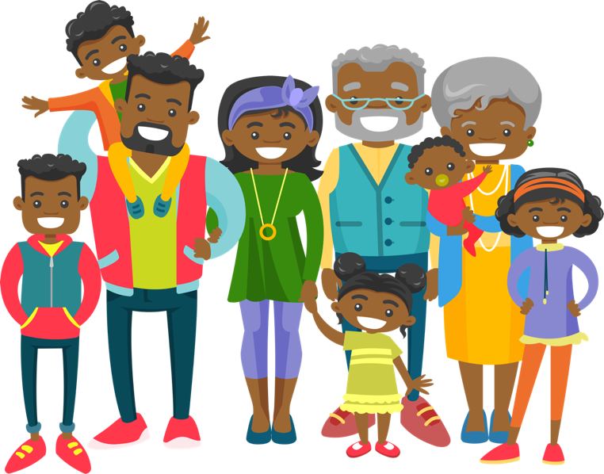
Who Do Nurses Care For?
And everyone in between
From children to teens to adults to seniors

Slide 13
Thinking of a Career in Nursing?
You can choose from over 675 nursing programs in the U.S.
Universities
Community colleges
Technical schools
Online courses

Slide 14
You Have So Many Career Options
The harder you work, the higher your degree
Certified Nursing Assistant (CNA)
Licensed Practical Nurse (LPN)
Nurse Practitioner (NP)
Advanced Practice Registered Nurse (APRN)
Registered Nurse (RN)

Slide 15
Hard Work Pays Off
You can make
a nice living
from nursing
(Earn from $40,000
to $100,000+ a year!)
&
You know you’re
doing something
good for your
community

Slide 16
How Do You Get Started?
Start now!
Work hard in school, especially In science and math
Get extra help when you need it; the best nurses ask questions
Talk to your parents, guidance counselor, or teachers about your future
Think college!

Slide 17
Why Choose To Be a Nurse?
You can help all kinds of people
in all kinds of places:
the possibilities
are endless
You have a
Passion
to care for
others
You want to
make a difference
in people’s
lives
You want to
constantly be
learning
You can
grow your career
and do different
things over time

Slide 18
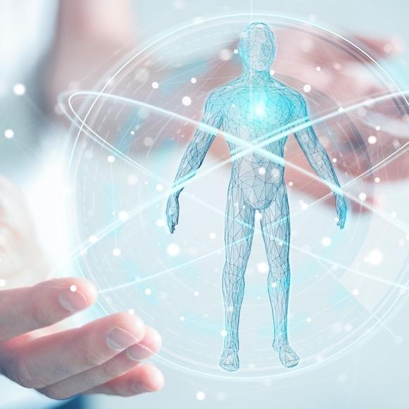
Fun Facts About the Human Body
(you may or may not learn in nursing school)

Slide 19
Did You Know That…
Your fingernails grow 4 times as fast as your toenails
Your brain weighs about three pounds, but over two pounds of that is water
In your very
own lifetime, you’ll produce enough spit to fill two swimming pools
You will be totally unable to lick your elbow, and I just know you’re going to try.
Every month you grow a new outer layer of skin
It’s totally impossible to sneeze with your eyes opened

Slide 20
Did You Know That…
You’re probably thinking "no way."
You breathe in about 7 quarts of air every minute. Good thing it's free!
By the time your grandmother is 72 years old, her heart will beat over two-and-a-half BILLION times!
Americans on average eat 18 acres of pizza every day
The length of your foot is the same as your forearm between your wrist and the inside of your elbow?
Relative to its size, the strongest muscle in the body is the TONGUE.
If you blink one eye you move over 200 muscles.
Concept credit to: Lisa Hezel, RN WCC CHT.
Facts courtesy of: Joan Fleitas, Ed.D., R.N.

Slide 22
Test Your Knowledge
Q
Question:
What is the
cause of the common
cold?
Not getting enough sleep
Touching a place where someone has sneezed
Cold weather
A tiny virus

Slide 23
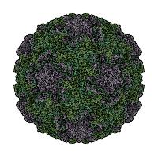
Test Your Knowledge
A
Answer:
A tiny virus
Rhinovirus, magnified about 2 million times
Specifically, the rhinovirus from rhino, the Greek word for nose. Viruses are tiny microbes--so small, they can’t be seen with an ordinary microscope.
Not to be confused with Rhinoceros

Slide 24
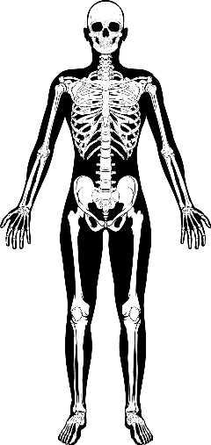
Test Your Knowledge
Q
Question: Where are the smallest bones in your body?
Nose
Knees
Ear
Toes

Slide 25
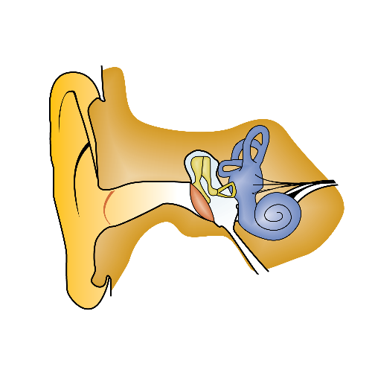
Test Your Knowledge
Hammer
A
Anvil
Answer:
In your inner ear
Stirrup
Three tiny bones, deep inside your head, carry sound from your eardrum to your brain

Slide 26
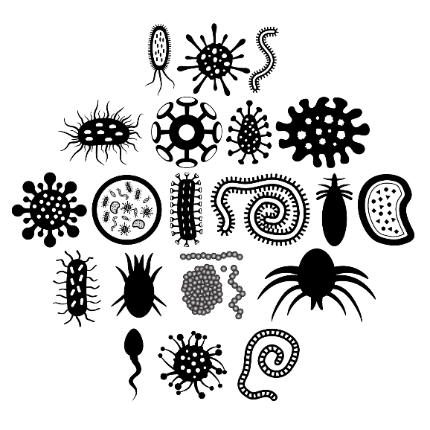
Test Your Knowledge
Q
Question: How many microbes live in your gut?
42
42 million
Billions and billions
Trillions

Slide 27
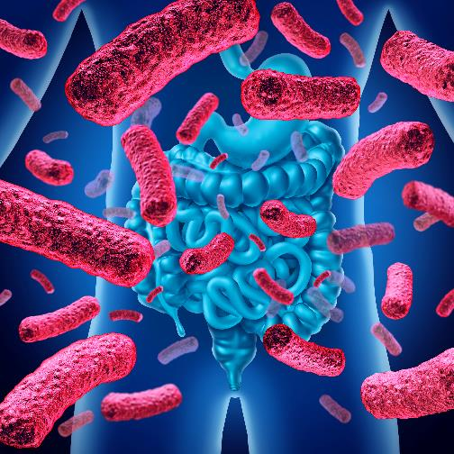
Test Your Knowledge
A
Answer:
Trillions
It’s a jungle in there! Bacteria, yeasts, funguses, viruses—lots of invisible, tiny microorganisms live almost everywhere in the body. But they belong there in our stomach and intestines. They help us digest our food.

Slide 28
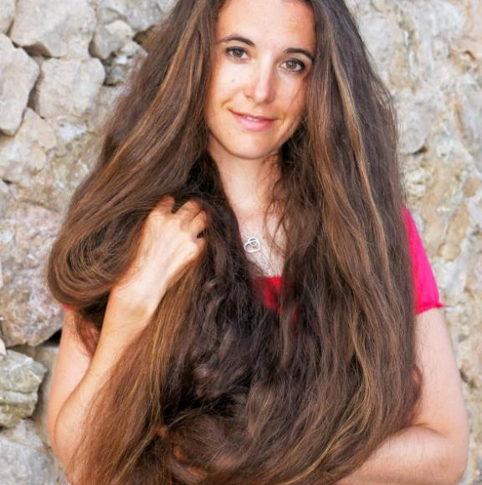
Test Your Knowledge
Q
Question:
How fast
does your
hair grow?
Two inches a month
Six feet a year
½ inch a month
Depends on your shampoo

Slide 29
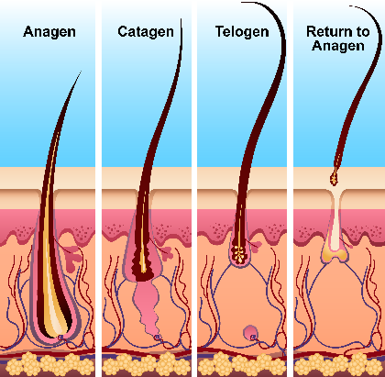
Test Your Knowledge
A
Answer: 1/2 inch a month, on average
Hair on the head usually won’t get more than three feet long. But in some people it can grow more. The Guinness World Record is over 18 feet!
Cells in our body called follicles grow hair. Hair usually grows to a certain length, then falls out. New hair grows to replace it.

Slide 30
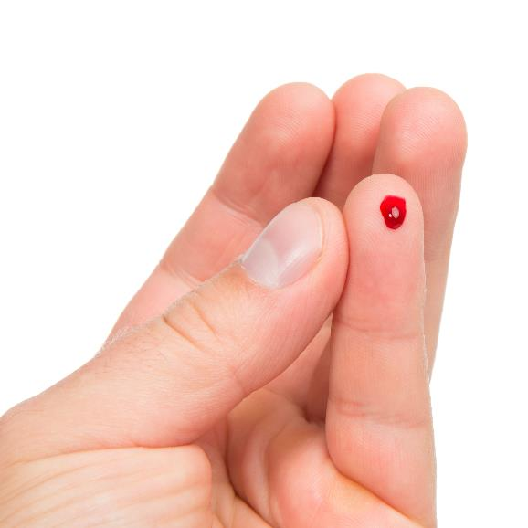
Test Your Knowledge
Q
Question: Why is your blood red?
Because it contains a chemical called hemoglobin
Actually, blood is blue but it turns red in air
Because it contains red paint
So it’s easy to see if you are bleeding

Slide 31
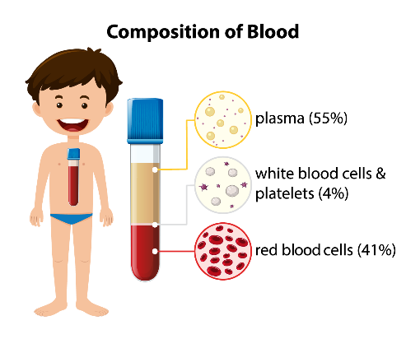
Test Your Knowledge
A
Answer: Because it contains hemoglobin
Blood gets its color from the red blood cells floating in it. They contain a chemical called hemoglobin. And hemoglobin is red.
We all need oxygen to live. Hemoglobin’s job is to grab oxygen from the air we breathe, and take it to all parts of our bodies

